Slide 1




AI-Powered Cricket Performance Prediction System
Predicting Player Runs and Wickets Using Machine Learning
Presented by,
Kommera Deepak

Slide 2

Introduction
Cricket analytics has evolved significantly with the availability of large-scale historical datasets from leagues such as the Indian Premier League (IPL).
However, predicting individual player performance remains challenging due to multiple influencing factors such as:
Opponent strength
Match venue
Player form
Match conditions
This project focuses on developing an AI-based system to predict:
Runs scored by a batsman
Wickets taken by a bowler
using historical IPL match data and machine learning techniques.

Slide 3




Problem Statement
Traditional cricket predictions rely heavily on manual analysis and expert intuition, which may not always provide consistent or accurate results.
Analyze large volumes of historical cricket data
Processing past match statistics to extract useful insights about player performance.
Identify meaningful performance patterns
Detecting trends and relationships that influence how players perform in different conditions.
Provide reliable predictions for players future performances
Using machine learning models to estimate upcoming player runs and wickets with accuracy.

Slide 4


Objectives
01
To perform data cleaning and preprocessing on IPL datasets.
02
To conduct exploratory data analysis (EDA) for insights.
03
To build machine learning models for performance prediction.
04
To develop a user-friendly Streamlit dashboard for predictions.
05
To evaluate model accuracy and effectiveness.

Slide 5
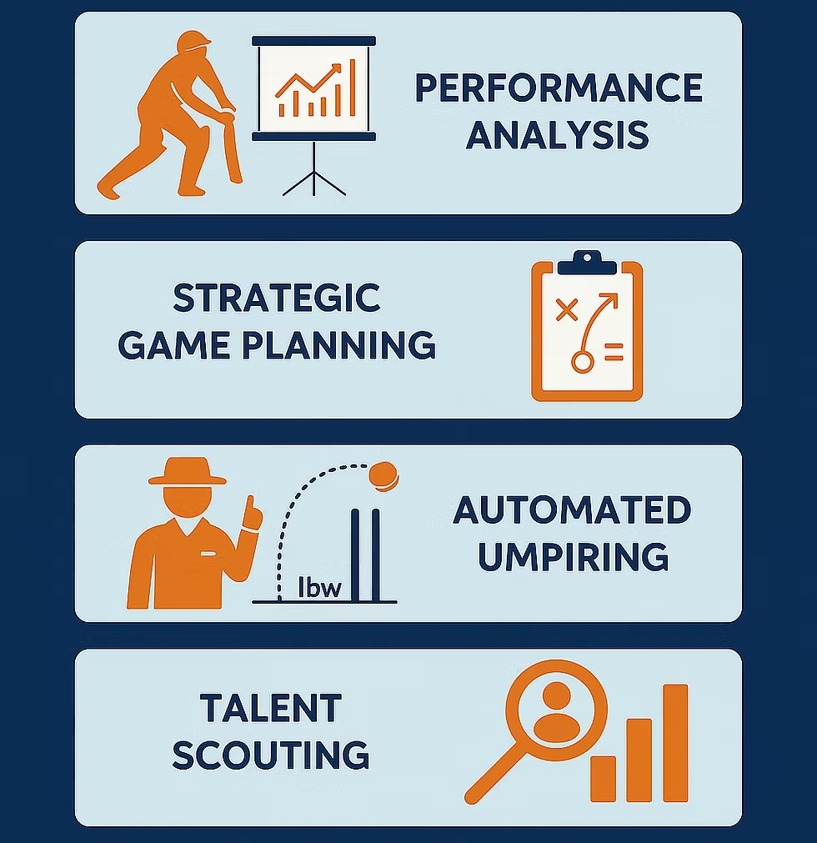
Dataset Description
The project uses historical IPL data including:
Ball-by-ball match records
Player performance statistics
Match details such as teams and venues
Key features used:
Player name
Opponent team
Venue
Batting position
Historical averages
Strike rate / economy rate
Previous performance metrics

Slide 6

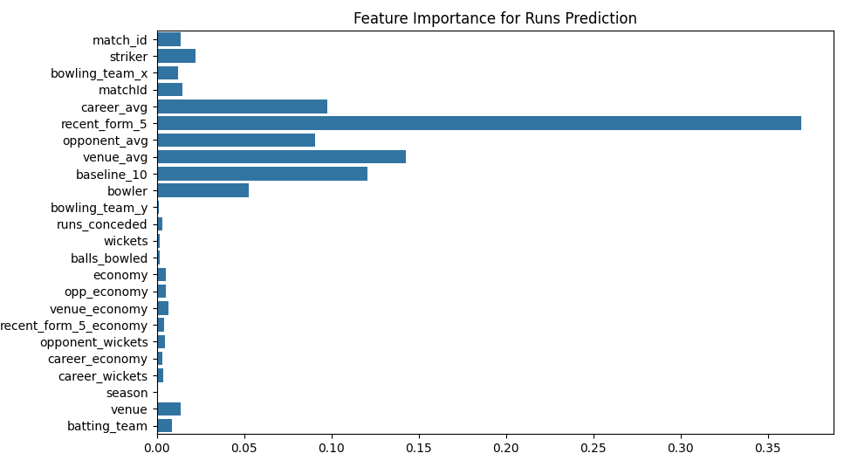
Data Preprocessing
Data preprocessing steps included:
Handling missing values
Standardizing team names
Removing duplicates
Feature engineering
Data aggregation at player level
Outlier detection and analysis
These steps ensured data quality and
improved model performance.

Slide 7
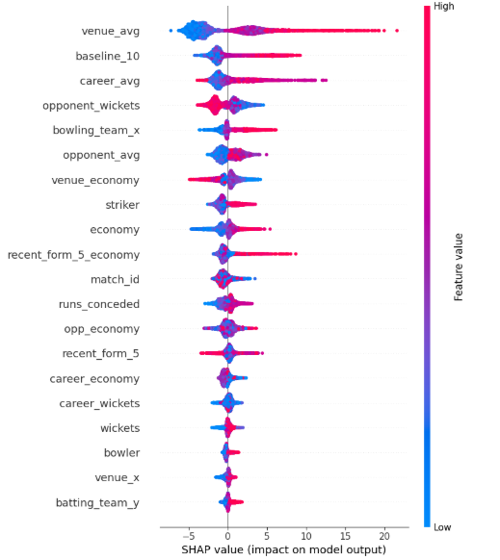
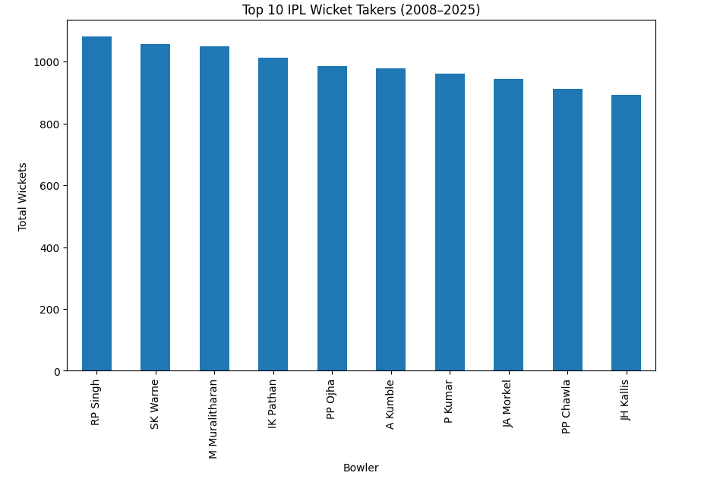
Exploratory Data Analysis (EDA)
EDA was performed to understand performance trends:
Runs distribution across players
Wickets distribution across bowlers
Performance by venue
Performance against opponents
Player consistency analysis
Visualizations helped identify patterns useful for model training.

Slide 8
Feature Engineering
New features were created to improve prediction accuracy:
01
Player average runs
05
Strike-Rate
02
Player average wickets
06
Economy rate
03
Opponent-wise performance
07
Recent form indicators
04
Venue-wise performance

Slide 9


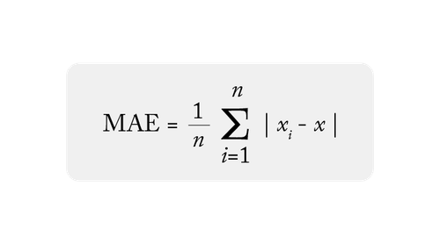

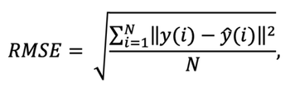
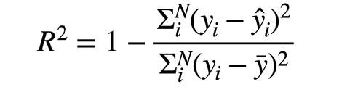

Machine Learning Models
The best performing models were selected based on evaluation metrics such as:
Multiple machine learning algorithms were evaluated:
XGBoost
Mean Absolute Error (MAE)
Root Mean Squared Error (RMSE)
Random Forest Regressor
LightGBM
R² Score

Slide 10

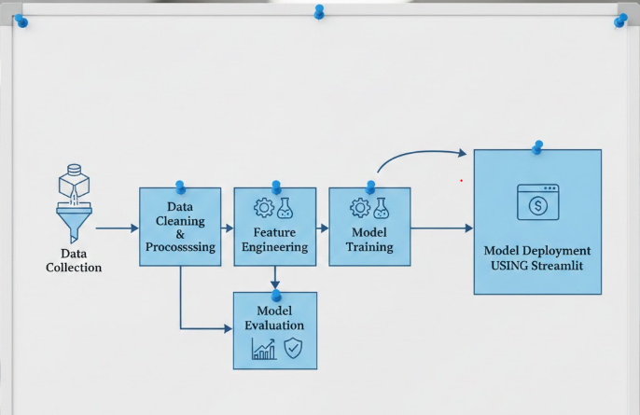
Model Architecture
System workflow:
Data Collection
Data Cleaning & Preprocessing
Feature Engineering
Model Training
Model Evaluation
Model Deployment using Streamlit
Separate models were trained for:
Runs Prediction
Wickets Prediction

Slide 11








Results & Performance
Accurate prediction of player runs
Reliable prediction of bowler wickets
Improved performance using engineered features
Consistent results across multiple test scenarios

Slide 12


Challenges Faced
Some challenges encountered:
Missing and inconsistent data
Feature selection complexity
Model overfitting risk
Large dataset processing time
Opponent-specific statistics computation
These were addressed through preprocessing and tuning.

Slide 13


Future Enhancements
Category | Enhancement Area | Description
Data Improvements | Real-Time & Advanced Data | Integrate live match data, include advanced player metrics like strike rate, economy, fitness, and expand dataset coverage.
Model Enhancements | Intelligent Prediction Models | Apply deep learning techniques, context-aware features (pitch, weather), and optimize models using tuning and ensembles.
System & User Features | Application & Visualization | Apply deep learning techniques, context-aware features (pitch, weather), and optimize models using tuning and ensembles.

Slide 14
Conclusion
This project successfully demonstrates how machine learning can be applied to sports analytics.
Key achievements:
Built predictive models for cricket performance
Developed an interactive dashboard
Provided data-driven insights for decision making
The system highlights the potential of AI in transforming sports analytics.

Slide 15

Thank You!!

